Slide 1
Automated Application Performance Analysis with Caliper, SPOT, and Hatchet
2022 ECP Annual Meeting Tutorial
May 2, 2022
David Boehme, Stephanie Brink, Olga Pearce

Slide 2
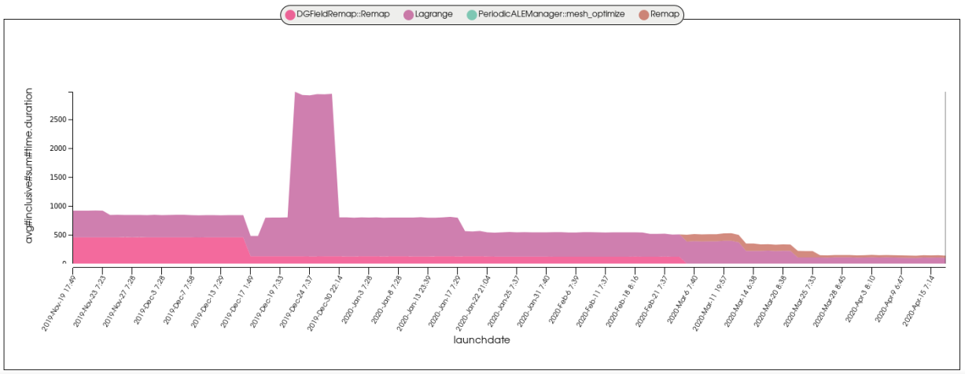
Building Automated Performance Analysis Workflows
Enabling performance analysis as a routine activity for HPC software development
Nightly test performance of a large physics code over 5 months
Notes:
This tutorial covers three tools - Caliper, SPOT, Hatchet - that allow you to set up automated performance analysis workflows for HPC software projects
There are many great profiling tools out there that help find performance bottlenecks - but these are geared toward interactive performance debugging and therefore applied retroactively and infrequently
We find it valuable to conduct performance analysis as a routine activity during software development
Our three tools enable “ubiquitous performance analysis” approach that allow you to do anything from running performance tests as part of nightly unit testing up to collecting performance data for every program run
Several large codes at LLNL now use this approach in production
Our tools are Caliper - instrumentation and profiling library; SPOT, a web framework for visualizing and analyzing large collections of runs; and Hatchet, a python library for call-graph analysis
Typical scenario is performance regression testing - instrument and run test code with Caliper, use SPOT to track performance over time; develop custom analysis scripts with Hatchet

Slide 3
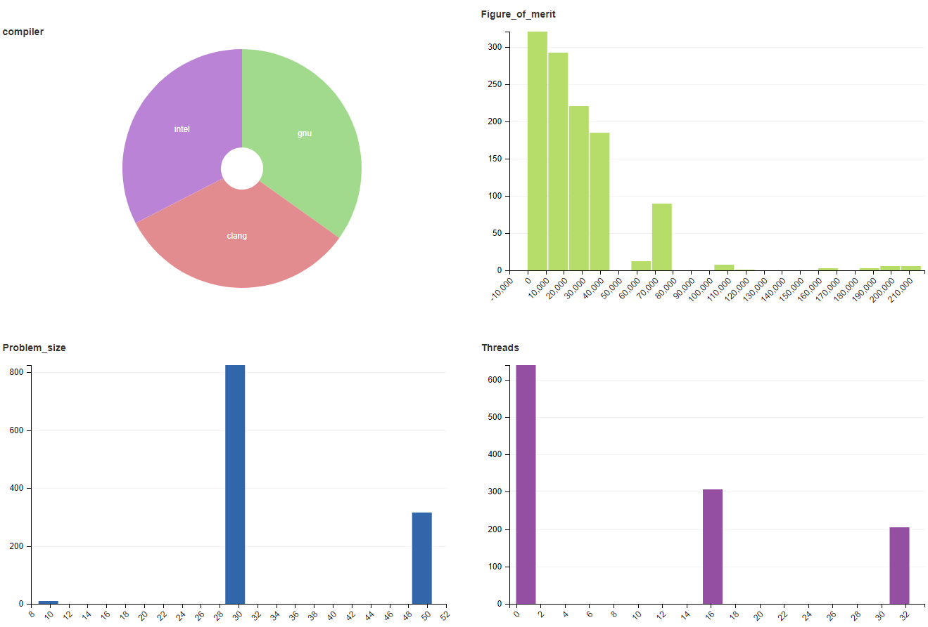

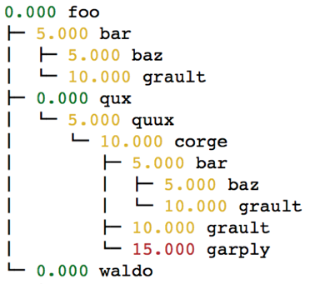
The LLNL Automated Profiling Software Stack
#include <caliper/cali.h>
void LagrangeElements(Domain& domain, Index_t numElem)
{
CALI_CXX_MARK_FUNCTION;
// ...
SPOT: Analysis of large collections of runs
Caliper: Instrumentation and Profiling
Hatchet: Call graph analysis in Python
Notes:
This tutorial covers three tools - Caliper, SPOT, Hatchet - that allow you to set up automated performance analysis workflows for HPC software projects
There are many great profiling tools out there that help find performance bottlenecks - but these are geared toward interactive performance debugging and therefore applied retroactively and infrequently
We find it valuable to conduct performance analysis as a routine activity during software development
Our three tools enable “ubiquitous performance analysis” approach that allow you to do anything from running performance tests as part of nightly unit testing up to collecting performance data for every program run
Several large codes at LLNL now use this approach in production
Our tools are Caliper - instrumentation and profiling library; SPOT, a web framework for visualizing and analyzing large collections of runs; and Hatchet, a python library for call-graph analysis
Typical scenario is performance regression testing - instrument and run test code with Caliper, use SPOT to track performance over time; develop custom analysis scripts with Hatchet

Slide 4
Caliper: A Performance Profiling Library
2022 ECP Annual Meeting: Tutorial
May 2, 2022
David Boehme
Computer Scientist

Slide 5
Caliper: A Performance Profiling Library
Integrates a performance profiler into your program
Profiling is always available
Simplifies performance profiling for application end users
Common instrumentation interface
Provides program context information for other tools
Advanced profiling features
MPI, CUDA, HIP, Kokkos support; call-stack sampling; hardware counters; memory profiling
Notes:
Profiling always available: more regular than with traditional tools, including production runs
Serves as common instrumentation interface
Profiling features for HPC
Split out Kokkos

Slide 6
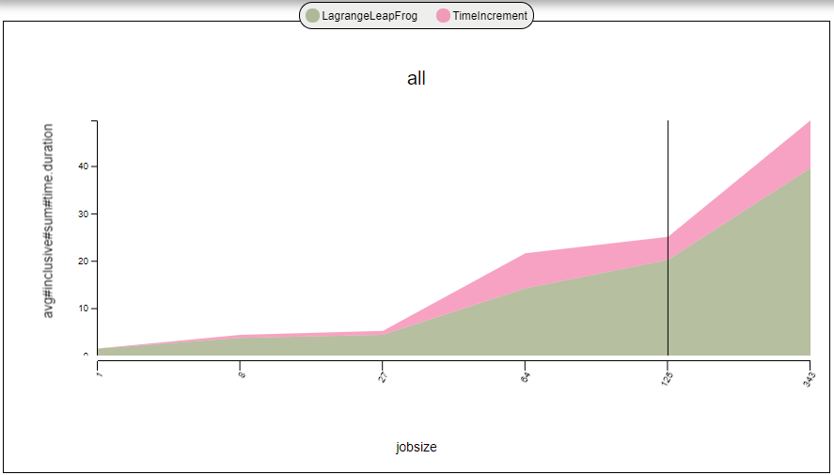
Caliper Use Cases
Lightweight always-on profiling
Performance summary report for each run
Performance debugging
Performance introspection
Comparison studies across runs
Performance regression testing
Configuration and scaling studies
Automated workflows
Performance reports
Path Min time/rank Max time/rank Avg time/rank Time %
main 0.000119 0.000119 0.000119 7.079120
mainloop 0.000067 0.000067 0.000067 3.985723
foo 0.000646 0.000646 0.000646 38.429506
init 0.000017 0.000017 0.000017 1.011303
Comparing runs
Debugging
Notes:
Mention configurability (lightweight vs. detailed options)

Slide 7
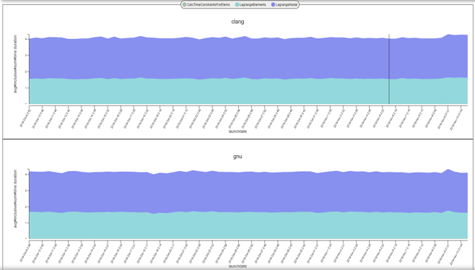
Performance Analysis with Caliper, SPOT and Hatchet
Pre-populated Jupyter notebooks
“spot” config
SPOT web frontend: Analysis of large collections of runs
#include <caliper/cali.h>
void LagrangeElements(Domain& domain, Index_t numElem)
{
CALI_CXX_MARK_FUNCTION;
// ...
Caliper: Instrumentation and Profiling
Hatchet: Call graph analysis in Python
hatchet-region-profile, hatchet-sample-profile
Notes:
Caliper fits into a larger performance analysis ecosystem with SPOT and Hatchet.
SPOT is a web-based visualization framework for analyzing large collections of runs. Several teams use it for performance regression testing, where they do nightly test runs to track performance over time.
Hatchet is a Python library for analyzing call graph data.
Caliper is the instrumentation and profiling component here, collects data for SPOT, and for Hatchet.

Slide 8
Materials, Contact & Links
Tutorial materials: https://github.com/daboehme/caliper-tutorial
GitHub repository: https://github.com/LLNL/Caliper
Documentation: https://llnl.github.io/Caliper
GitHub Discussions: https://github.com/LLNL/Caliper/discussions
Contact: David Boehme (boehme3@llnl.gov)
$ git clone --recursive https://github.com/daboehme/caliper-tutorial.git
$ . setup-env.sh
Notes:
Shout-out to Caliper users
Part of the ECP stack

Slide 9
Using Caliper

Slide 10
Using Caliper: Workflow
cali::ConfigManager mgr;
mgr.add(opts.caliperConfig.c_str());
mgr.start();
// ...
mgr.flush();
Path Min time/rank Max time/rank
main 0.000119 0.000119
mainloop 0.000067 0.000067
foo 0.000646 0.000646
init 0.000017 0.000017
Human-readable reports
ConfigManager API
#include <caliper/cali.h>
void LagrangeElements(Domain& domain, Index_t numElem)
{
CALI_CXX_MARK_FUNCTION;
// ...
Source-code annotation API
$ CALI_CONFIG=runtime-report ./app
Profile/trace data processing (e.g., Hatchet)
Environment variables
Code Instrumentation
Runtime Configuration
Data Analysis

Slide 11
Region Profiling: Marking Code Regions
Use annotation macros (C/C++) or functions to mark and name code regions
C/C++
Fortran
#include <caliper/cali.h>
void main() {
CALI_MARK_BEGIN(”init”);
do_init();
CALI_MARK_END(”init”);
}
USE caliper_mod
CALL cali_begin_region(‘init’)
CALL do_init()
CALL cali_end_region(‘init’)
Notes:
Core functionality in Caliper is region profiling.
Started out as a source-code instrumentation library.
It has an API to let you mark regions of interest in a program. There are high-level macros for C and C++ and functions for Fortran to do that.
Overhead is low, annotations can stay in the code.

Slide 12
Region Profiling: Best Practices
Be selective: Instrument high-level program subdivisions (kernels, phases, ...)
Be clear: Choose meaningful names
Start small: Add instrumentation incrementally
RAJA::ReduceSum<RAJA::omp_reduce, double> ompdot(0.0);
CALI_MARK_BEGIN(”dotproduct”);
RAJA::forall<RAJA::omp_parallel_for_exec>(RAJA::RangeSegment(0, N), [=] (int i) {
ompdot += a[i] * b[i];
});
dot = ompdot.get();
CALI_MARK_END(”dotproduct”);
Caliper annotations give meaningful names to high-level program constructs
Notes:
How do you go about instrumenting a code? Be selective: don’t instrument every function, but high-level subdivisions.
Typically have no more than 20 or so regions even in large production codes.
Annotations are not meant to pinpoint bottlenecks, but to monitor performance over time
Use options like call-path sampling if more detail is needed
Choose names that are meaningful to developers

Slide 13
Region Profiling: Printing a Runtime Report
$ cd Caliper/build
$ make cxx-example
$ CALI_CONFIG=runtime-report ./examples/apps/cxx-example
Path Min time/rank Max time/rank Avg time/rank Time %
main 0.000119 0.000119 0.000119 7.079120
mainloop 0.000067 0.000067 0.000067 3.985723
foo 0.000646 0.000646 0.000646 38.429506
init 0.000017 0.000017 0.000017 1.011303
Set the CALI_CONFIG environment variable to access Caliper’s built-in profiling configurations
“runtime-report” measures, aggregates, and prints time in annotated code regions
Notes:
Once region annotations are in-place we can run performance measurements.
Easiest way to do that is to use one of Caliper’s built-in measurement recipes.
We can enable those with the CALI_CONFIG environment variable. Here we activate the runtime-report config.

Slide 14
List of Caliper’s Built-in Profiling Configurations
Config name | Description
runtime-report | Print a time profile for annotated regions
loop-report | Print summary and time-series information for loops
mpi-report | Print time spent in MPI functions
callpath-sample-report | Print time spent in functions using call-path sampling
event-trace | Record a trace of region enter/exit events in .cali format
hatchet-region-profile | Record a region time profile for processing with hatchet or cali-query
hatchet-sample-profile | Record a sampling profile for processing with hatchet or cali-query
spot | Record a time profile for the SPOT web visualization framework
Use mpi-caliquery --help=configs to list all built-in configs and their options

Slide 15
Built-In Profiling Configurations: Configuration String Syntax
Config name specifies the kind of performance measurement
Parameters enable additional features, metrics, or output options
$ CALI_CONFIG=“runtime-report(mem.highwatermark,output=stdout)” ./examples/apps/cxx-example
Path Min time/rank Max time/rank Avg time/rank Time % Allocated MB
main 0.000179 0.000179 0.000179 2.054637 0.000047
mainloop 0.000082 0.000082 0.000082 0.941230 0.000016
foo 0.000778 0.000778 0.000778 8.930211 0.000016
init 0.000020 0.000020 0.000020 0.229568 0.000000
Most Caliper measurement configurations have optional parameters to enable additional features or configure output settings

Slide 16
Profiling Options: MPI Function Profiling
$ CALI_CONFIG=runtime-report,profile.mpi ./lulesh2.0
Path Min time/rank Max time/rank Avg time/rank Time %
MPI_Comm_dup 0.000034 0.003876 0.001999 0.10089
main 0.009013 0.010797 0.010173 0.51335
MPI_Reduce 0.000031 0.000049 0.000037 0.001886
lulesh.cycle 0.002031 0.002258 0.002085 0.105220
LagrangeLeapFrog 0.002158 0.002511 0.002227 0.112366
CalcTimeConstraintsForElems 0.015166 0.015443 0.015277 0.770922 CalcQForElems 0.058781 0.060196 0.059699 3.01254
CalcMonotonicQForElems 0.035331 0.041057 0.038496 1.942601
CommMonoQ 0.005280 0.006152 0.005544 0.279781
MPI_Wait 0.004182 0.084533 0.035324 1.78249
CommSend 0.006893 0.009062 0.008071 0.407298
MPI_Waitall 0.000986 0.001778 0.001343 0.067789
MPI_Isend 0.004564 0.005785 0.004930 0.248765
CommRecv 0.002265 0.002616 0.002341 0.118144
[...]
The profile.mpi option measures time spent in MPI functions

Slide 17
Profiling Options: CUDA Profiling
$ lrun -n 4 ./tea_leaf runtime-report,profile.cuda
Path Min time/rank Max time/rank Avg time/rank Time %
timestep_loop 0.000175 0.000791 0.000345 0.002076
[...]
total_solve 0.000105 0.000689 0.000252 0.001516
solve 0.583837 0.617376 0.594771 3.581811
dot_product 0.000936 0.001015 0.000969 0.005837
cudaMalloc 0.000060 0.000066 0.000063 0.000382
internal_halo_update 0.077627 0.079476 0.078697 0.473925
halo_update 0.158597 0.161853 0.160023 0.963685
halo_exchange 1.502106 1.572522 1.532860 9.231136
cudaMemcpy 11.840890 11.871018 11.860343 71.424929
cudaLaunchKernel 1.177454 1.230816 1.211668 7.296865
cudaMemcpy 0.470123 0.471485 0.470596 2.834008
cudaLaunchKernel 0.658269 0.682566 0.673030 4.053100
[...]
The profile.cuda option measures time in CUDA runtime API calls
Notes:
Make sure people understand config strings (passed into ConfigManager)

Slide 18
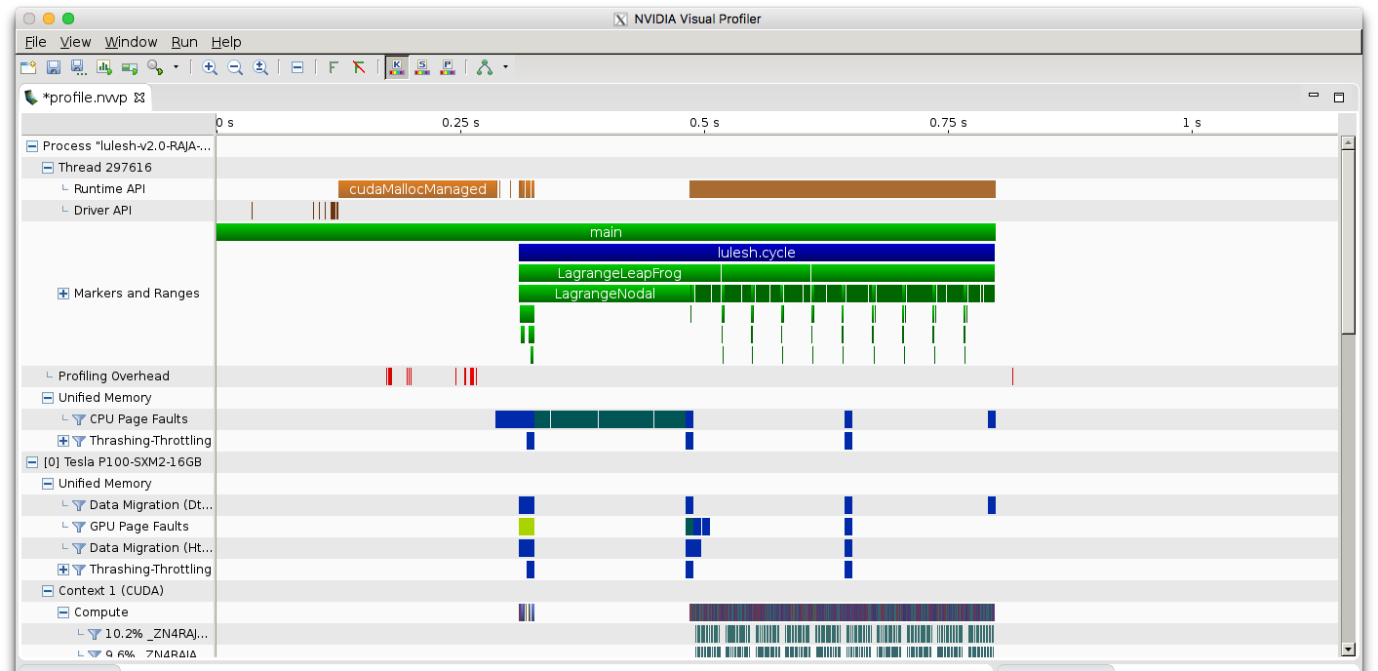
Forwarding Annotations to Third-Party Tools
$ CALI_CONFIG=nvtx nvprof <nvprof-opts> ./app
Caliper regions shown in NVVP
The nvtx config forwards annotations to NVidia’s NVTX API
Notes:
Many tools have their own source-code annotation APIs. We provide adapters for them.

Slide 19
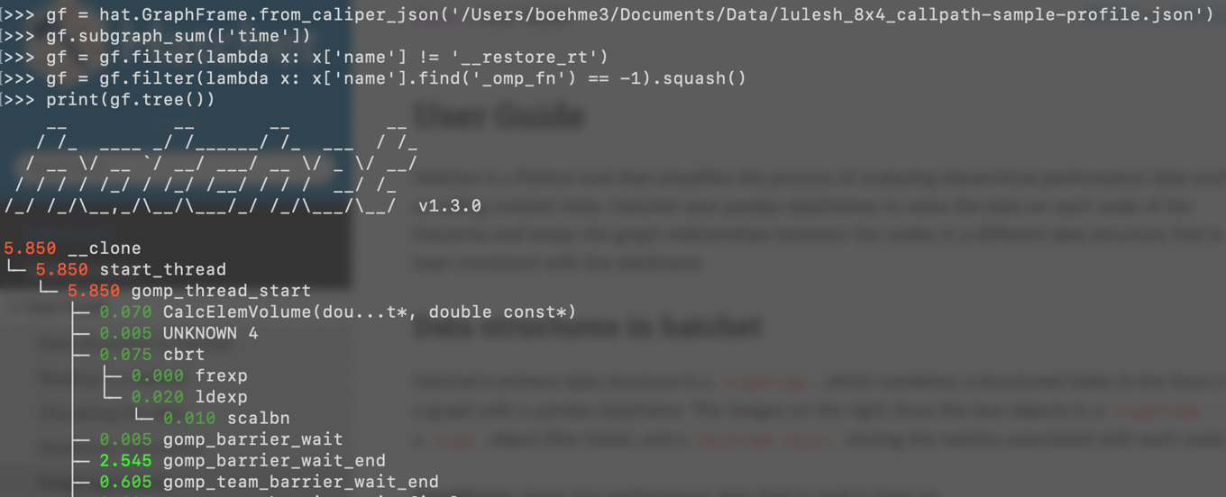
Call Graph Analysis with the Hatchet Python Library
Caliper records data for hatchet with hatchet-region-profile or hatchet-sample-profile
$ CALI_CONFIG=hatchet-sample-profile srun -n 8 ./lulesh2.0
Hatchet allows manipulation, computation, comparison, and visualization of call graph data

Slide 20
Control Profiling Programmatically: The ConfigManager API
#include <caliper/cali.h>
#include <caliper/cali-manager.h>
int main(int argc, char* argv[])
{
cali::ConfigManager mgr;
mgr.add(argv[1]);
if (mgr.error())
std::cerr << mgr.error_msg() << “\n”;
mgr.start();
// ...
mgr.flush();
}
Use ConfigManager to access Caliper’s built-in profiling configurations
$ ./examples/apps/cxx-example -P runtime-report
Now we can use command-line arguments or other program inputs to enable profiling

Slide 21
Manual Configuration Allows Custom Analyses
cali-query -q "select alloc.label#cupti.fault.addr as Pool,
cupti.uvm.kind as UVM\ Event,
scale(cupti.uvm.bytes,1e-6) as MB,
scale(cupti.activity.duration,1e-9) as Time
group by
prop:nested,alloc.label#cupti.fault.addr,cupti.uvm.kind
where cupti.uvm.kind format tree” trace.cali
caliper.config
CALI_SERVICES_ENABLE=alloc,cupti,cuptitrace,mpi,trace,recorder
CALI_ALLOC_RESOLVE_ADDRESSES=true
CALI_CUPTI_CALLBACK_DOMAINS=sync
CALI_CUPTITRACE_ACTIVITIES=uvm
CALI_CUPTITRACE_CORRELATE_CONTEXT=false
CALI_CUPTITRACE_FLUSH_ON_SNAPSHOT=true
Path
main
solve
TIME_STEPPING
enforceBC
CURVI in EnforceBC
CurviCartIC
CurviCartIC::PART 3 Pool UVM Event MB Time
curvilinear4sgwind UM_pool pagefaults.gpu 2.806946
curvilinear4sgwind UM_pool HtoD 7862.747136 0.232238
curvilinear4sgwind UM_pool_temps pagefaults.gpu 0.130167
curvilinear4sgwind UM_pool DtoH 9986.441216 0.378583
curvilinear4sgwind UM_pool pagefaults.cpu
Mapping CPU/GPU unified memory transfer events to Umpire memory pools in SW4
Notes:
If none of the built-in configurations do what you want, you can configure Caliper manually.
Caliper comes with many service modules that implement some specific measurement functionality. You can compose and configure these in many different ways.
Here we’re recording unified memory data transfers between CPU and GPU memory, and map those events back to named memory buffers and code regions.
This produces a trace, and we can use a query tool with its own query language to produce this report.
So Caliper provides the building blocks for you to create very specific performance analysis solutions.

Slide 22
Caliper Output Formats and Processing Workflows
*-report configs
Human-readable report
SPOT web frontend
spot
.cali
hatchet-region-profile
hatchet-sample-profile
.json
Hatchet
cali-query -q ...
recorder (manual config)
event-trace
spot
.cali
caliper-reader
Python library

Slide 23
Recording Data for SPOT

Slide 24
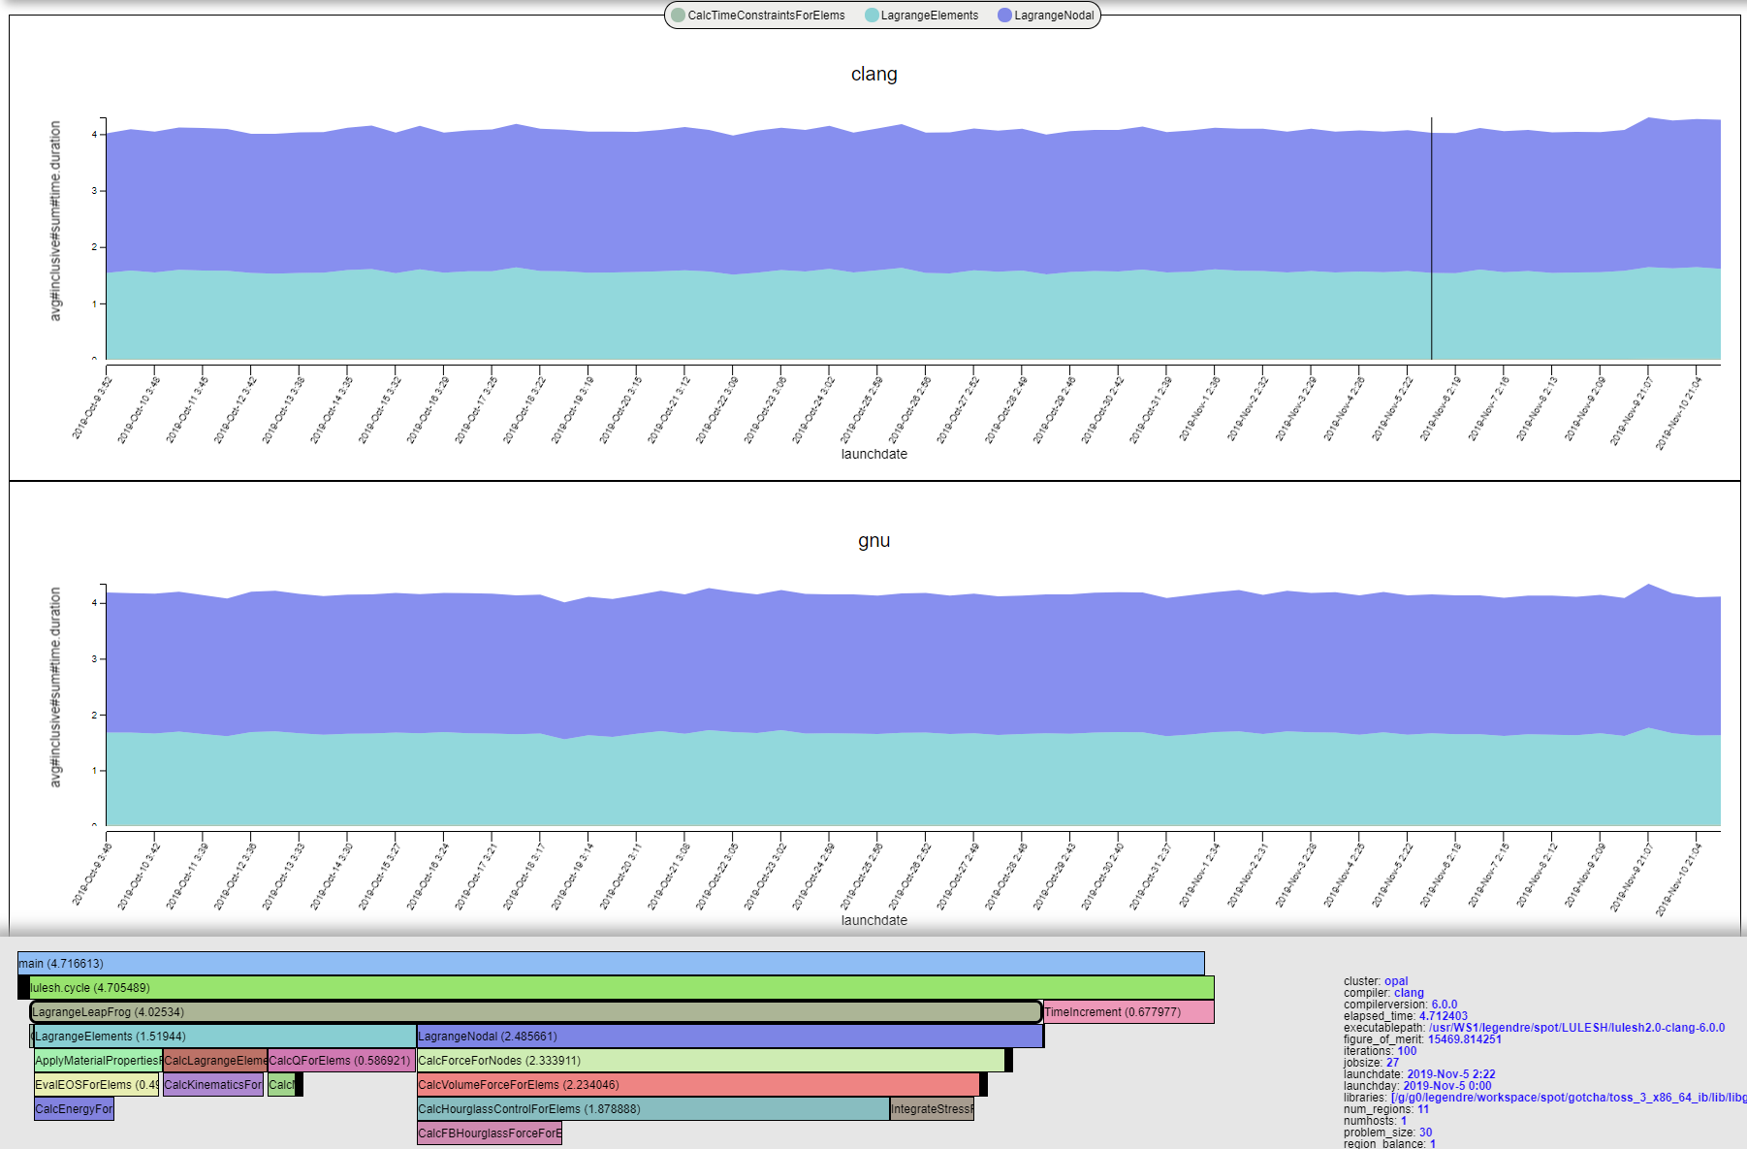
Recording Data for SPOT with Caliper and Adiak
#include <caliper/cali.h>
void LagrangeElements(Domain& domain, Index_t numElem)
{
CALI_CXX_MARK_FUNCTION;
// ...
Region instrumentation
SPOT
Web
GUI
adiak::clustername();
adiak::jobsize();
adiak::value("iterations", opts.its);
adiak::value("problem_size", opts.nx);
adiak::value("num_regions", opts.numReg);
Metadata
collection
[adiak]
cali::ConfigManager mgr;
mgr.add(opts.caliperConfig.c_str());
mgr.start();
// ...
mgr.flush();
Profile data
(.cali)
Experiment directory
Caliper configuration
$ ./app –P spot
Run program with the “spot” profiling config
Notes:
Need new SPOT picture
Motivate metadata: don’t compare 1D test runs and 3D physics runs; examples (Bob vs. Developers, MPI job sizes, nightly tests across runs, build config)

Slide 25
Recording Program Metadata with the Adiak Library
TeaLeaf_CUDA example [C++]
#include <adiak.hpp>
adiak::user();
adiak::launchdate();
adiak::jobsize();
adiak::value("end_step", readInt(input, "end_step"));
adiak::value(”halo_depth", readInt(input, ”halo_depth"));
if (tl_use_ppcg) {
adiak::value(“solver”, “PPCG”);
// [...]
Use built-in Adiak functions to collect common metadata
Use key:value functions to collect program-specific data
Use the Adiak C/C++ library to record program metadata
Environment info (user, launchdate, system name, ...)
Program configuration (input problem description, problem size, ...)
Enables performance comparisons across runs. Required for SPOT.

Slide 26
Adiak: Built-in Functions for Common Metadata
adiak_user(); /* user name */
adiak_uid(); /* user id */
adiak_launchdate(); /* program start time (UNIX timestamp) */
adiak_executable(); /* executable name */
adiak_executablepath(); /* full executable file path */
adiak_cmdline(); /* command line parameters */
adiak_hostname(); /* current host name */
adiak_clustername(); /* cluster name */
adiak_job_size(); /* MPI job size */
adiak_hostlist(); /* all host names in this MPI job */
adiak_walltime(); /* wall-clock job runtime */
adiak_cputime(); /* job cpu runtime */
adiak_systime(); /* job sys runtime */
Adiak comes with built-in functions to collect common environment metadata
SPOT requires at least launchdate

Slide 27
Adiak: Recording Custom Key-Value Data in C++
C++
#include <adiak.hpp>
vector<int> ints { 1, 2, 3, 4 };
adiak::value(“myvec”, ints);
adiak::value(“myint”, 42);
adiak::value(“mydouble”, 3.14);
adiak::value(“mystring”, “hi”);
adiak::value(“mypath”, adiak::path(“/dev/null”));
adiak::value(“compiler”, adiak::version(“gcc@8.3.0”));
Adiak supports many basic and structured data types
Strings, integers, floating point, lists, tuples, sets, ...
adiak::value() records key:value pairs with overloads for many data types
Notes:
Discuss weirdly complex types

Slide 28
Adiak: Recording Custom Key-Value Data in C
C
#include <adiak.h>
int ints[] = { 1, 2, 3, 4 };
adiak_nameval(“myvec”, adiak_general, NULL, “[%d]”, ints, 4);
adiak_nameval(“myint”, adiak_general, NULL, “%d”, 42);
adiak_nameval(“mydouble”, adiak_general, NULL, “%f”, 3.14);
adiak_nameval(“mystring”, adiak_general, NULL, “%s”, “hi”);
adiak_nameval(“mypath”, adiak_general, NULL, “%p”, “/dev/null”);
adiak_nameval(“compiler”, adiak_general, NULL, “%v”, “gcc@8.3.0”);
In C, adiak_nameval() uses printf()-style descriptors to determine data types

Slide 29
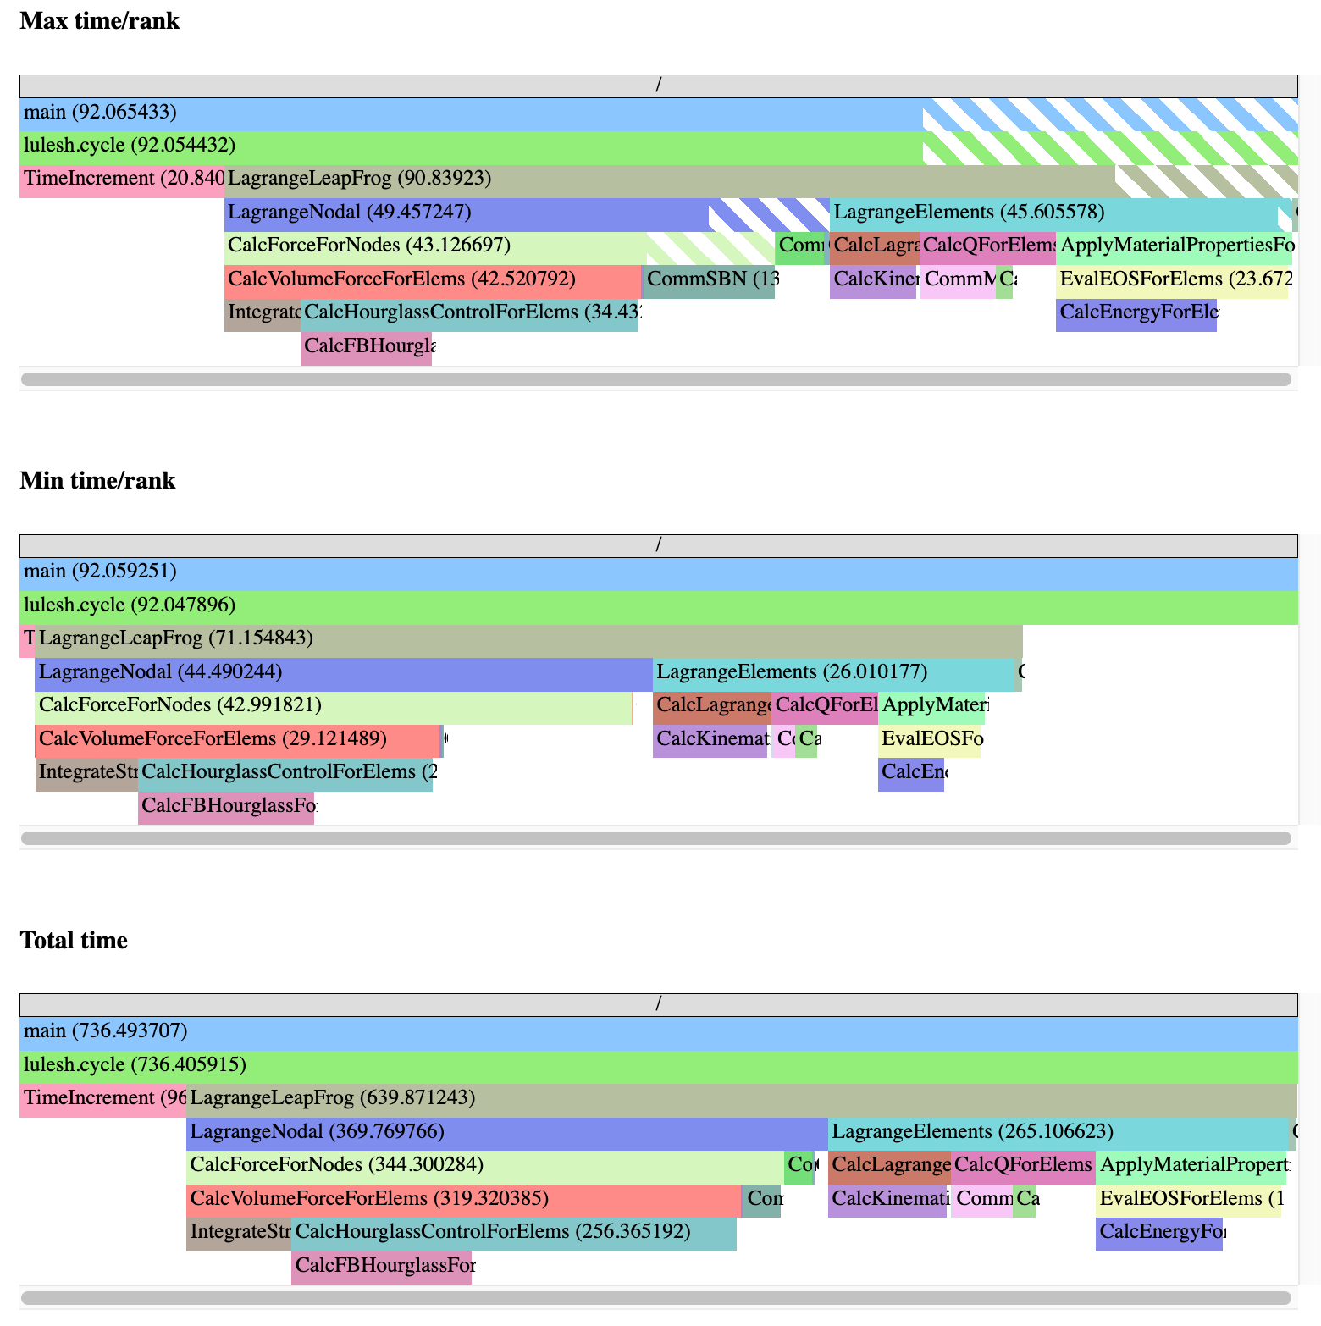
The spot config: Region Profiling
$ CALI_CONFIG=spot,profile.mpi ./lulesh2.0
$ ls *.cali
210304-17175150010.cali
“spot” records and aggregates time spent in instrumented regions, like runtime-report
Supports many profiling options (e.g., MPI function profiling)
Collect profiling output (.cali files) in a directory for analysis in SPOT
SPOT region profile flame graphs

Slide 30
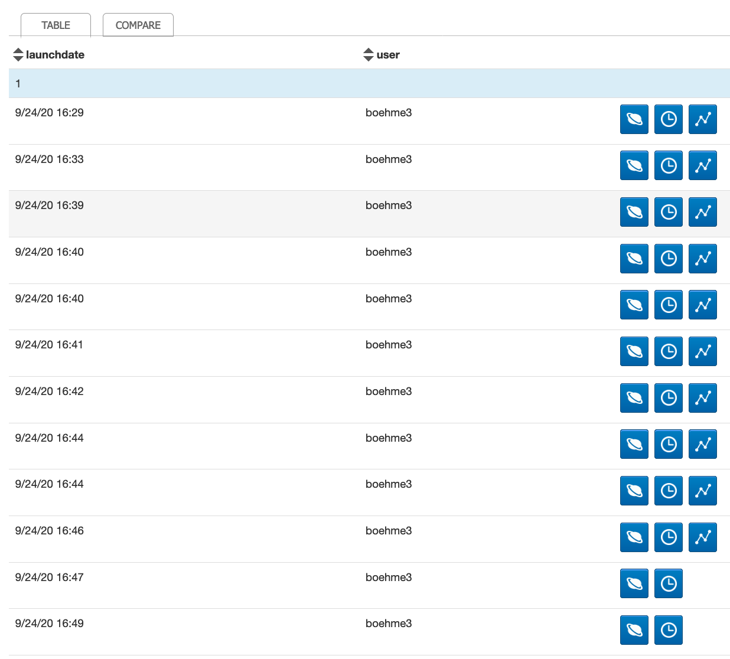
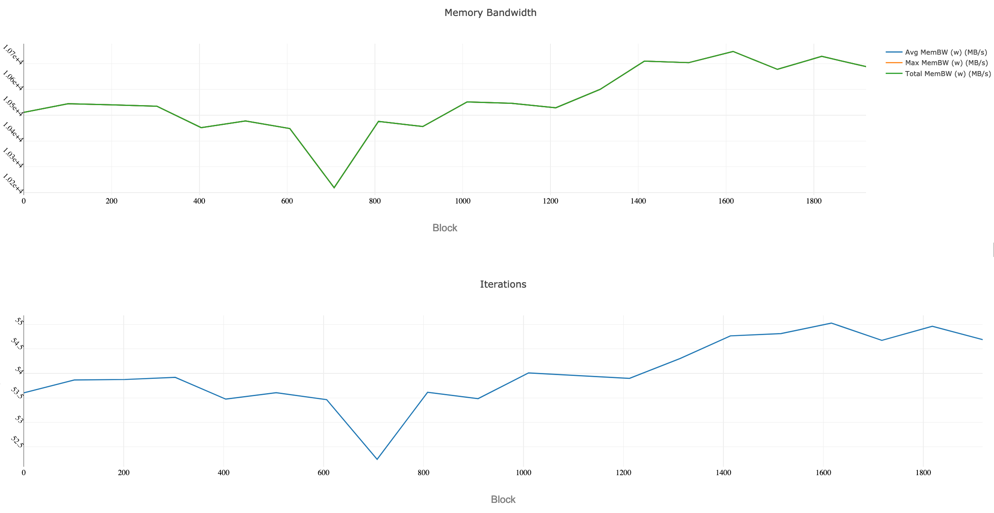
The spot config: Loop Profiling
$ CALI_CONFIG=spot,timeseries=true,timeseries.metrics=mem.bandwidth ./app
Enable the “timeseries” option to record loop profiles for SPOT
Use “timeseries.metrics” to enable metric options for the loop profile
Timeseries data available
SPOT loop profile visualization

Slide 31
Example: Caliper and Adiak in LULESH

Slide 32
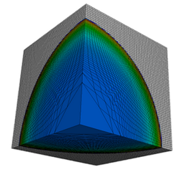
Modified LULESH Proxy App with Caliper and Adiak Support
https://github.com/daboehme/LULESH/tree/adiak-caliper-support
$ mpirun -n 8 ./lulesh2.0 -P runtime-report,profile.mpi
Path Min time/rank Max time/rank Avg time/rank Time %
MPI_Comm_dup 0.000034 0.003876 0.001999 0.10089
main 0.009013 0.010797 0.010173 0.51335
MPI_Reduce 0.000031 0.000049 0.000037 0.001886
lulesh.cycle 0.002031 0.002258 0.002085 0.105220
LagrangeLeapFrog 0.002158 0.002511 0.002227 0.112366
CalcTimeConstraintsForElems 0.015166 0.015443 0.015277 0.770922
CalcQForElems 0.058781 0.060196 0.059699 3.01254
CalcMonotonicQForElems 0.035331 0.041057 0.038496 1.942601
CommMonoQ 0.005280 0.006152 0.005544 0.279781
MPI_Wait 0.004182 0.084533 0.035324 1.78249
CommSend 0.006893 0.009062 0.008071 0.407298
MPI_Waitall 0.000986 0.001778 0.001343 0.067789
MPI_Isend 0.004564 0.005785 0.004930 0.248765
CommRecv 0.002265 0.002616 0.002341 0.118144
[...]

Slide 33
LULESH Example: Region Annotations
void CalcLagrangeElements(Domain& domain)
{
CALI_CXX_MARK_FUNCTION;
...
Function annotation in LULESH
Top-level functions provide meaningful basis for performance analysis in LULESH
Annotated 17 out of 39 computational functions and 5 communication functions

Slide 34
LULESH Example: Main Loop Annotation
CALI_CXX_MARK_LOOP_BEGIN(cycleloop, "lulesh.cycle");
while((locDom->time() < locDom->stoptime()) && (locDom->cycle() < opts.its)) {
CALI_CXX_MARK_LOOP_ITERATION(cycleloop, locDom->cycle());
// ...
}
CALI_CXX_MARK_LOOP_END(cycleloop);
Main loop annotation in LULESH
Annotation of the main time-stepping loop and iterations for loop profiling

Slide 35
LULESH Example: Initialization and ConfigManager
adiak::init(adiak_comm_p);
cali::ConfigManager mgr; if (!opts.caliperConfig.empty())
mgr.add(opts.caliperConfig.c_str());
if (mgr.error())
std::cerr << "Caliper config parse error: " << mgr.error_msg() << std::endl;
mgr.start();
// ...
mgr.flush();
MPI_Finalize();
ConfigManager setup in LULESH
Profiling control via ConfigManager API
Modified LULESH command-line parsing code to read Caliper config string (not shown)

Slide 36
LULESH Example: Recording Metadata With Adiak
void RecordGlobals(const cmdLineOpts& opts, int num_threads)
{
adiak::user();
adiak::launchdate();
adiak::executablepath();
adiak::libraries();
adiak::cmdline();
adiak::clustername();
adiak::jobsize();
adiak::value("threads", num_threads); adiak::value("iterations", opts.its);
adiak::value("problem_size", opts.nx);
adiak::value("num_regions", opts.numReg);
adiak::value("region_cost", opts.cost);
adiak::value("region_balance", opts.balance);
}
void VerifyAndWriteFinalOutput(...)
{
// ...
adiak::value("elapsed_time", elapsed_time);
adiak::value("figure_of_merit", 1000.0/grindTime2);
}
Recording global performance metrics at program end
Recording environment and LULESH config
Adiak calls record environment info, LULESH configuration options, and global performance metrics

Slide 37
LULESH Example: Build System Modifications
find_package(caliper REQUIRED)
find_package(adiak REQUIRED)
# ...
add_executable(${LULESH_EXEC} ${LULESH_SOURCES})
target_include_directories(${LULESH_EXEC} PRIVATE ${caliper_INCLUDE_DIR} ${adiak_INCLUDE_DIRS})
target_link_libraries(${LULESH_EXEC} caliper adiak)
CMakeLists.txt
Using caliper and adiak find_package() support in LULESH CMake script

Slide 38
SPOT Tutorial Slides
2022 ECP Annual Meeting
May 2, 2022
Matthew LeGendre

Slide 39
Getting SPOT
LLNL installation: https://lc.llnl.gov/spot2
Docker container: https://github.com/LLNL/spot2_container

Slide 40
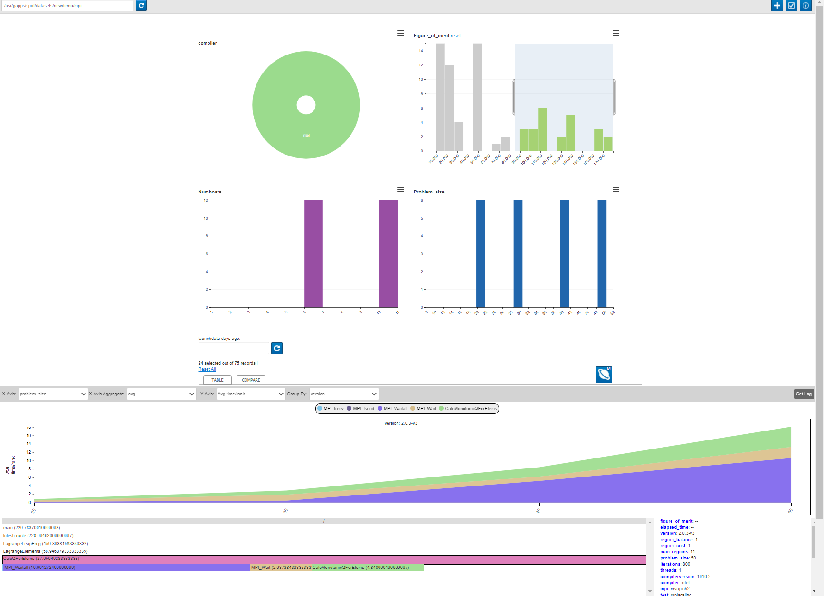
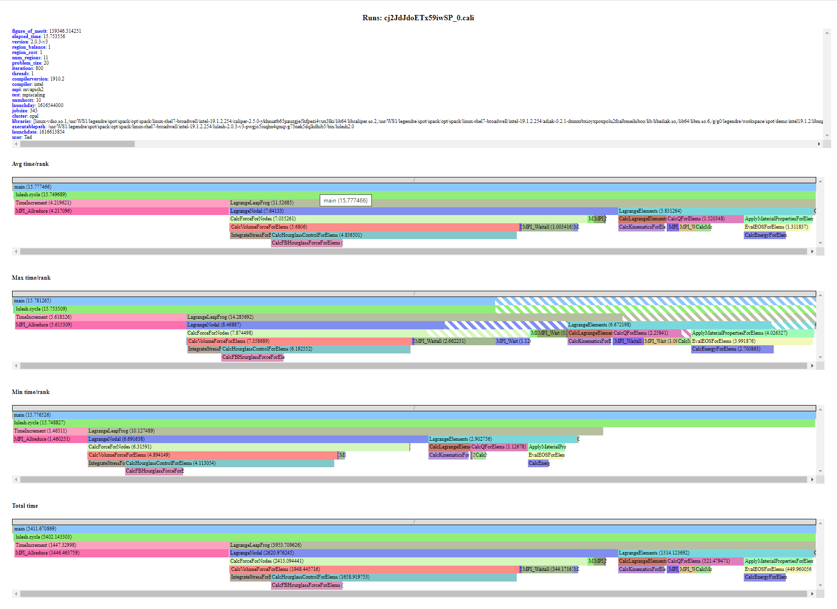
SPOT: Software Performance and Analysis Tracking
SPOT is visualization for collections of performance profiles. Common uses cases are:
Performance comparison of nightly tests. Look for performance regressions.
Performance tracking of developer changes. Run an MPI scaling study.
Collect performance profiles from users. Understand how users run and hit performance issues.

Slide 41
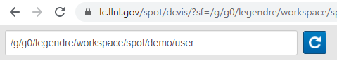
SPOT’s Workflow
Point SPOT webpage at directory containing *.cali files.
Select “interesting” sets of runs to analyze
Don’t compare performance of 1d test run. vs 3d multi-physics run.
Run common analysis with SPOT.
i.e., Graph history of performance changes
i.e., View performance context trees
Run advanced analysis with Hatchet.

Slide 42
SPOT’s Landing Page
Data Source
Config
Meta- data
Perf. Compare

Slide 43
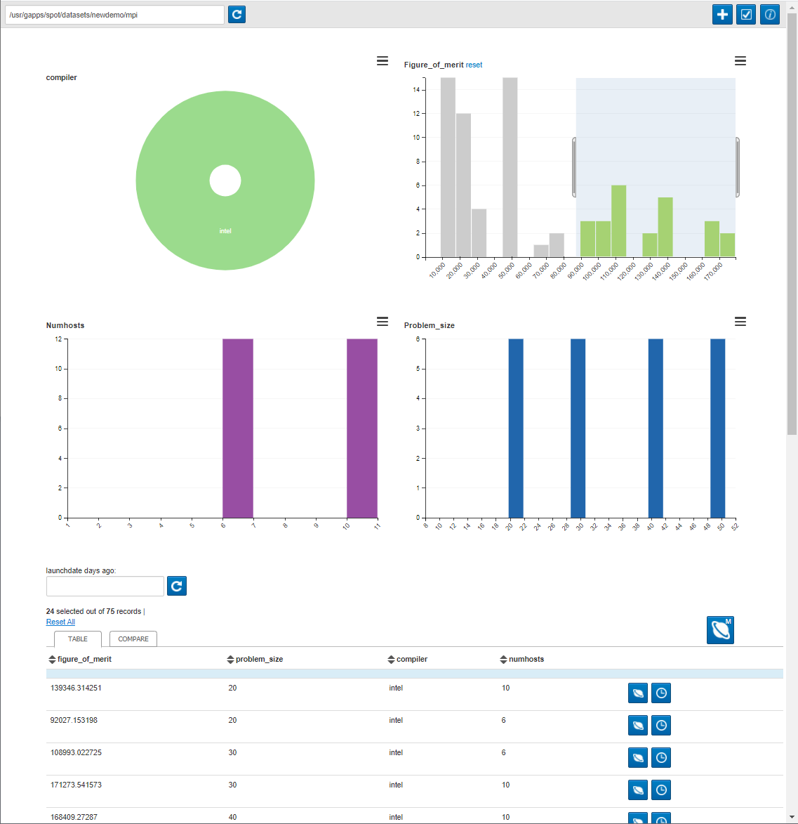
SPOT’s Landing Page
Table View

Slide 44
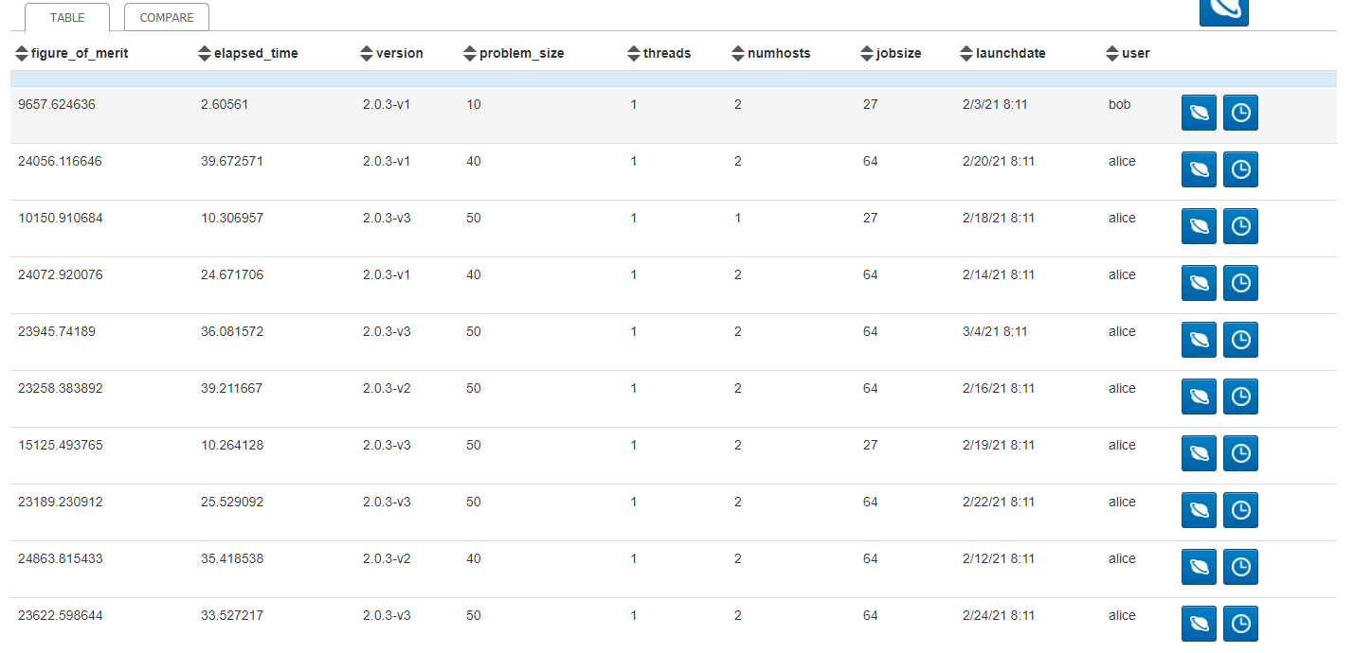
SPOT is Based on CrossFilter
SPOT’s Crossfilter: https://dc-js.github.io/dc.js/ D3-Based Crossfilter: https://square.github.io/crossfilter/
CrossFilter is good at finding correlations in data.
Crossfilter helps you manage/slice your data to make interesting comparisons.

Slide 45
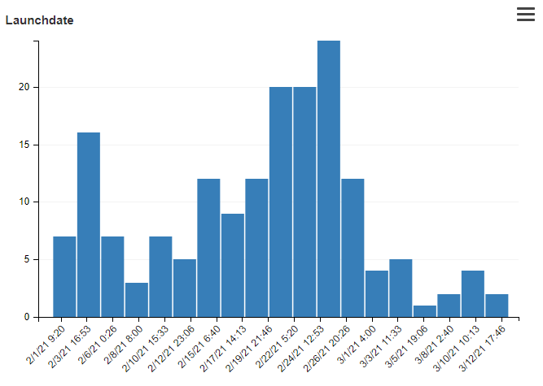
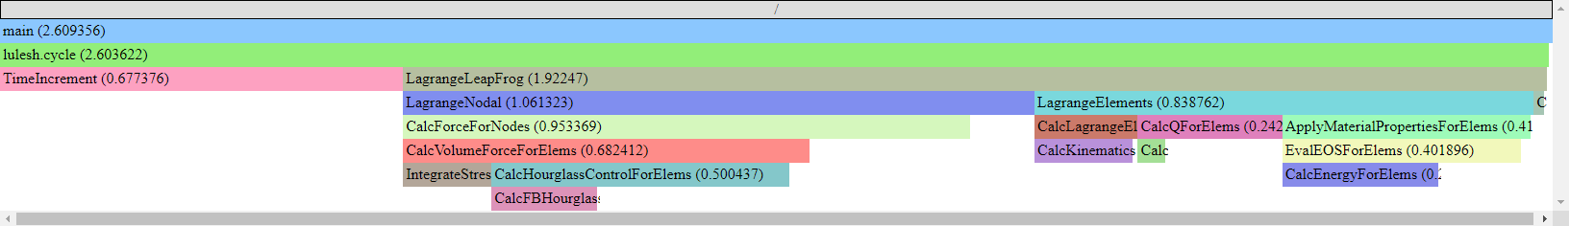
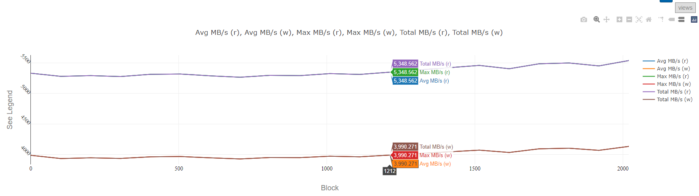
Each App Run has Two Types of Data
Metadata
Name/value data about job.
User, host, FOM, input parameters, …
Displayed as histograms
Performance Data
Can be different metrics.
Avg Time/Rank, Max Time/Rank, bandwidth, …
Displayed as a flame graph or timeseries.

Slide 46
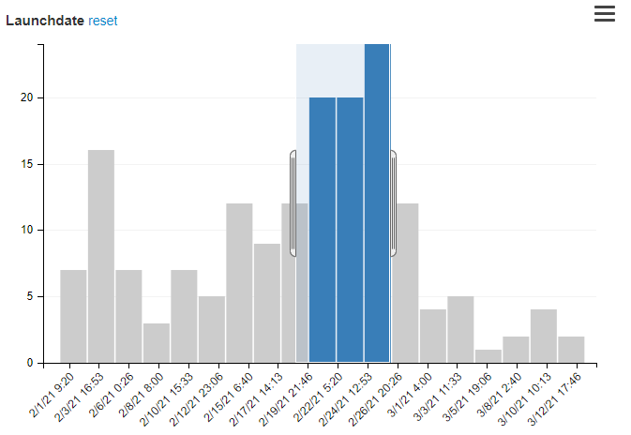
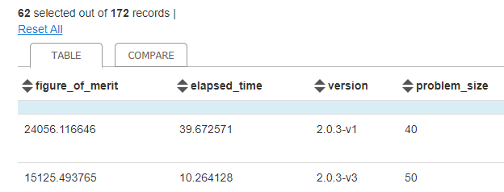
Metadata Can be Filtered
Select regions of metadata histograms to filter.
Filtering in one histogram updates all histograms range.
E.g., Filtering Launchdate to ‘Feb 19-Feb26’ will update the ‘Users’ histogram to only show users who ran between those dates.
While filtered, comparisons and Jupyter notebooks will operate on the filtered data.

Slide 47
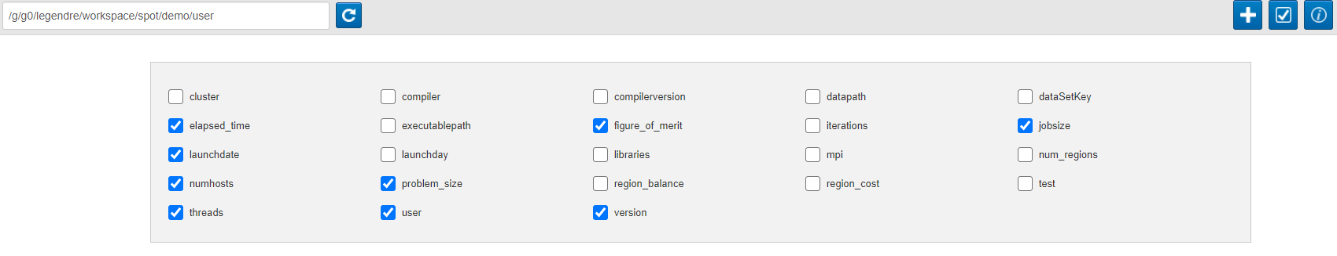
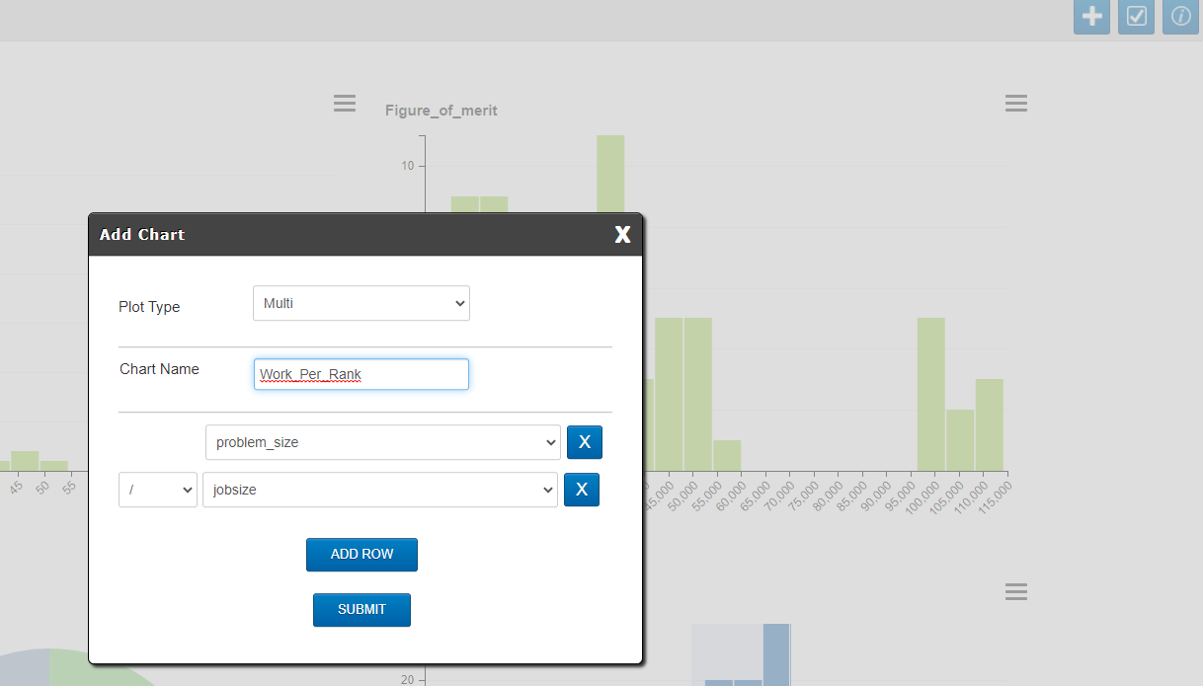
Metadata is Configurable
Can show/hide metadata:
Can create composite metadata:

Slide 48
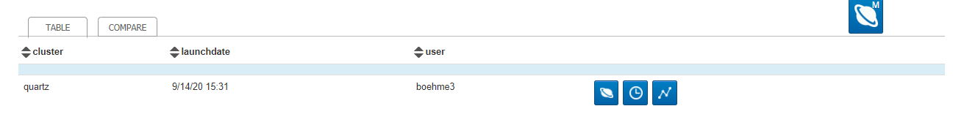
Performance Data can be Visualized Per-Run
FlameGraph: performance against code
Timeseries: performance against time

Slide 49
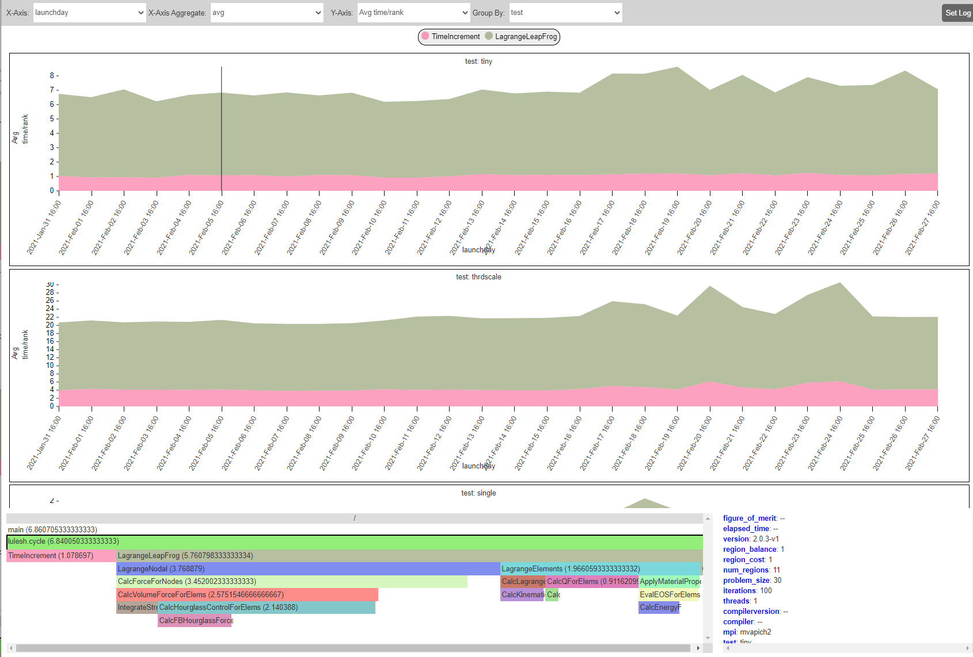
Performance Data can be Compared Across Runs
1
2
3
4
5
Metadata value on x-axis
Aggregation (min/max/avg…) if multiple runs at same point.
Metric to graph on y-axis.
Grouping metadata. Each unique value is a graph.
Stacked performance graph. Click to drill-down.
Flame graph for runs currently under cursor.
Metadata for runs currently under cursor.
6
7

Slide 50
Live Demo

Slide 51
Notes:
Future work

